Slide 1
EMBEDDED SYSTEMS DESIGN PROCESS

Slide 2
INTRODUCTION
Electronic products involving microcontrollers are most efficiently developed using an orderly approach to the process, using a progression of steps, from conception through accomplishment, that virtually always results in success.

Slide 3
CONCEPT DEVELOPMENT PHASE
Every project is based on an idea or concept, which comes from any need—somebody “wants one.”
The need may be to fill a gap in a product market, to improve a production process, to meet a course requirement, or simply to create something that has not been created before.
Because projects are often started to satisfy a need, the original description of the project is sometimes called a problem statement or a need statement.

Slide 4
PROJECT DEVELOPMENT PROCESS STEPS
The steps you should follow in the process of developing a project are as follows:
Definition phase
Design phase
Test definition phase
Build and test the prototype hardware phase
System integration and software development phase
System test phase
Celebration phase ☺

Slide 5
Definition phase
PROJECT DEVELOPMENT STEP

Slide 6
DEFINITION PHASE - INPUTS
Objective: To clearly state what the project is to accomplish
Specify what the device is to do
Is the project feasible?
Develop a list of specifications that fully describe the function of the project
Provide a formal proposal to go ahead with the project
This step is also know as the feasibility study phase
The early portion of this research will result in a coarse or macro-level block diagram;

Slide 7
DEFINITION PHASE - OUTPUTS
A complete set of specification is developed
Electrical specifications
Operating specification and human Interface
Function specifications
Summary of research and feasibility testing
Anticipated budget for the project
Timeline (schedule) for the completion of the project
Bottom line : Convince the management that the project will be successful and that their money will not be lost

Slide 8
Requirements analysis
Requirements: informal description of what customer wants.
Specification: precise description of what design team should deliver.
Requirements phase links customers with designers.

Slide 9
Types of requirements
Functional: What the device will do. This include the input/output relationships.
Non-functional:
timing;
power consumption;
manufacturing cost;
physical size;
time-to-market;
reliability.

Slide 10
Good requirements
Correct.
Unambiguous.
Complete.
Verifiable: is each requirement satisfied in the final system?
Consistent: requirements do not contradict each other.

Slide 11
Good requirements, cont’d.
Modifiable: can update requirements easily.
Traceable:
know why each requirement exists;
go from source documents to requirements;
go from requirement to implementation;
back from implementation to requirement.

Slide 12
Setting requirements
Customer interviews.
Comparison with competitors.
Sales feedback.
Mock-ups, prototypes.
Next-bench syndrome (HP): design a product for someone like you – very bad ☹

Slide 13
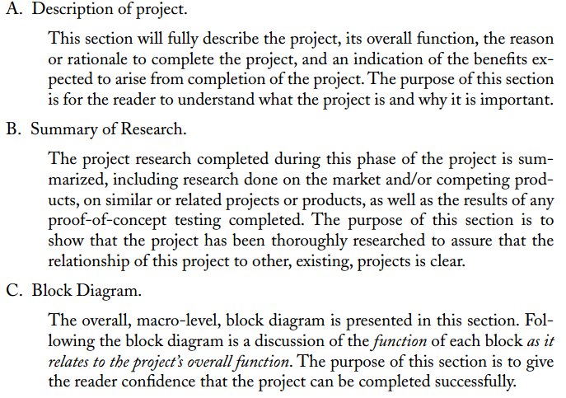
PROJECT PROPOSAL OUTLINE

Slide 14
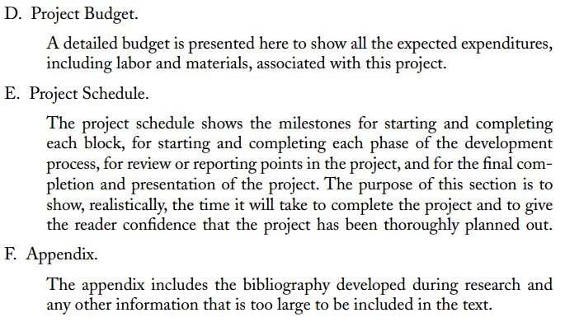
PROJECT PROPOSAL OUTLINE

Slide 15
Design phase
PROJECT DEVELOPMENT STEP

Slide 16
DESIGN PHASE
Goal: Translate the definition phase into actual circuitry and plan out, in flowchart form, the project firmware
This phase takes 40-50% of the total project time
The design phase of the project does not involve any prototyping of hardware or writing of any software.

Slide 17
HARDWARE DEVELOPMENT STEPS
STEP #1 - Start with the basic block diagram developed during the definition phase. The objective of this step is to provide a starting point in the form of blocks that you know will provide the desired results if you can fill in the blocks with appropriate circuitry.
STEP #2 - Thoroughly research both relevant components and circuits to determine what sort of circuitry and components could be used to fill each block.
The objective is to break each block into the smallest pieces that you plan to individually test.
When complete, each block should be labeled with its input and output voltage levels and/or signals.

Slide 18
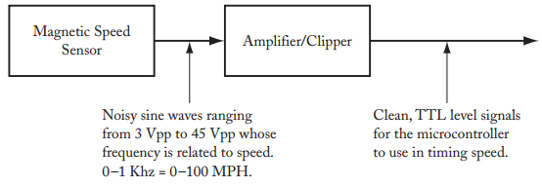
STEP #2 - EXAMPLE
If you were developing a device to record automobile parameters such as speed of the vehicle, gasoline consumption, and the deflection of the springs,

Slide 19
HARDWARE DEVELOPMENT STEPS
STEP #3 – Using your research as a basis, develop a tentative circuit schematic for each of the blocks that contain electronic circuitry.
Use a circuit simulator such as Spice or Proteus to simulate the operation of your circuitry.
Modify your circuitry as required until the simulator says it works correctly to fulfill the purpose of the block
STEP #4 - Use the individual block circuits to create an overall schematic for the project.

Slide 20
SOFTWARE DEVELOPMENT STEPS
List the tasks to be completed by the software.
Prioritize the tasks and determine which are critical and will need to be handled on an interrupt basis and which are less critical.
Create a software flowchart or outline for each interrupt function.
Create a software flowchart or outline of the program code to complete the project’s entire task.

Slide 21
TEST DEFINITION PHASE
The test definition phase of the project has the goal of ensuring that the project meets all of its specifications and goals (determined in the project definition phase) through the development of a test specification for the project.
The test specification is divided into two parts:
intermediate tests
final, or system, tests.

Slide 22
BUILD AND TEST THE PROTOTYPE HARDWARE PHASE
In this step, you should construct and thoroughly test the hardware for the prototype project.
At the completion of this step, you should be absolutely sure that the correct input signals are being applied to the microcontroller from each sensor and that the correct output signals from the microcontroller will drive the output circuitry in the expected manner.

Slide 23
SYSTEM INTEGRATION AND SOFTWARE DEVELOPMENT PHASE
This step is the software corollary to the hardware step above.
In this step, you are to write and test of each of the functions that you flowcharted or outlined when you designed the project.
Use a simple main() function to exercise each of the individual input device functions and output device functions so that, as with the hardware steps above, you are absolutely sure that each of the individual input and output functions works correctly.
Again, this step is to remove the uncertainty that will occur later when things do not work as you expect them to.
The goal of this step in the process is to have a fully working project using the real or simulated inputs and outputs.

Slide 24
SYSTEM TEST PHASE
During the system test phase, the project should be tested in accordance with the final test specification developed earlier to ensure that all of the specifications defined in the definition phase of the process are met.
Demonstration for the customer ☺☺☺☺

Slide 25
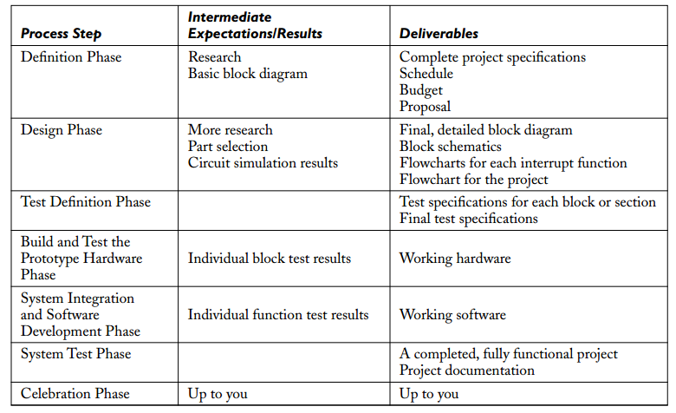
PROJECT DEVELOPMENT SUMMARY

